Slide 1
Chapter 5
Steady-State Sinusoidal Analysis

Slide 2
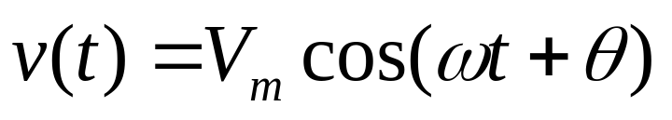
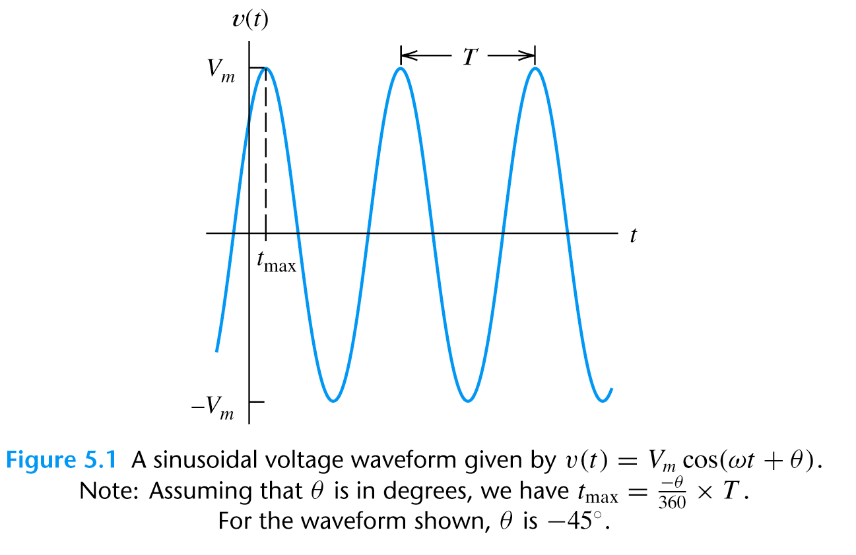



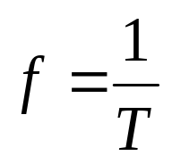
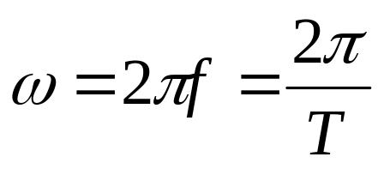
5.1 Sinusoidal Currents and Voltages
A sinusoidal voltage
Phase angle(相位)
Peak value
Angular frequency
(角頻率, rad/sec)
Period
(週期)
frequency
(頻率, Hz)

Slide 3
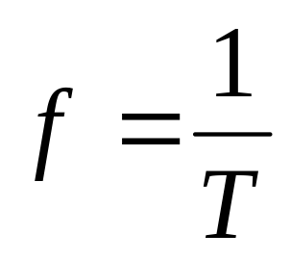
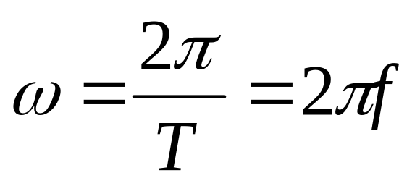
V_{m} is the peak value
ω is the angular frequency in radians per second
θ is the phase angle (0º~360º)
T is the period
Frequency
Angular frequency

Slide 4
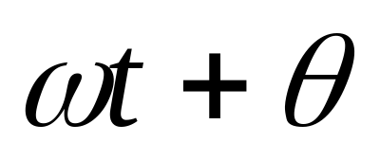
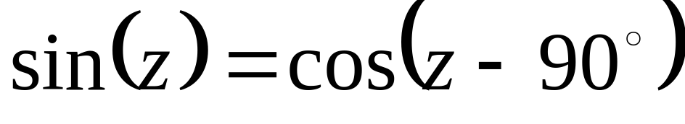
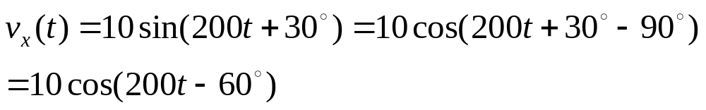
Radians
(0~2π)
Degree
(0º~360º)
For uniformity, we express sinusoidal functions by cosine function.
Ex

Slide 5
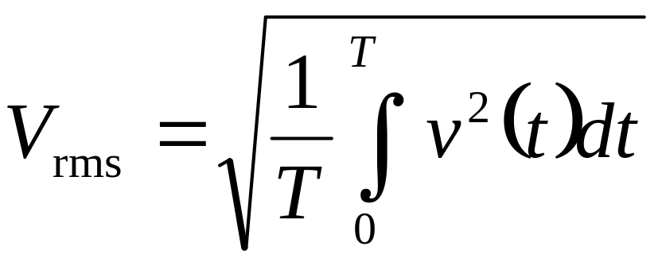
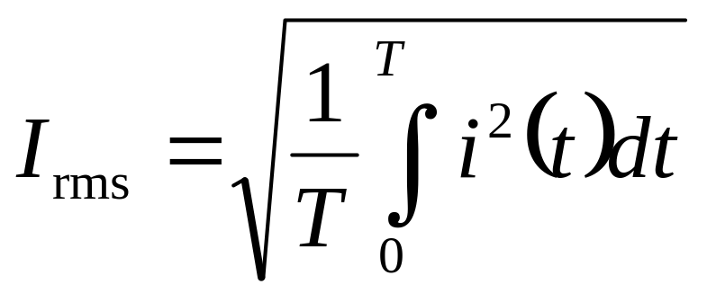
Root-Mean-Square (均方根)Values

Slide 6

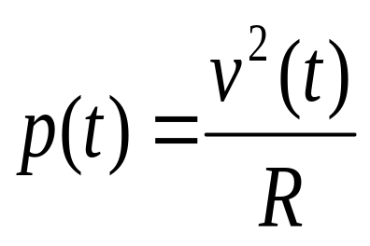
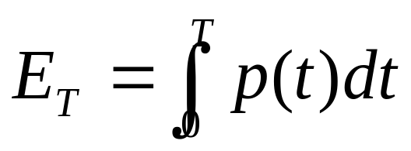
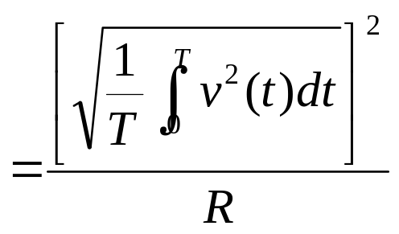
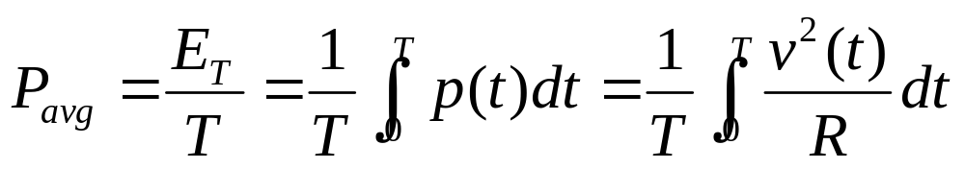
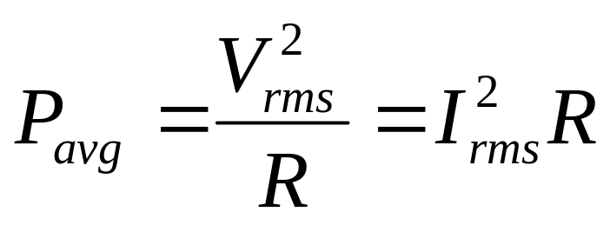
Root-Mean-Square (均方根)Values
假設電壓源(v(t))週期為T, 與電阻連接，計算其平均功率

Slide 7
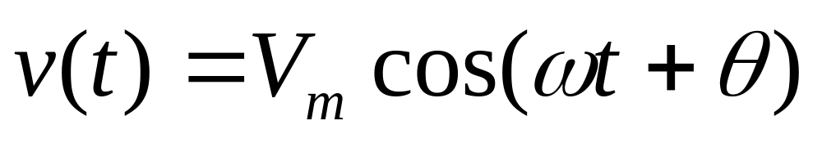
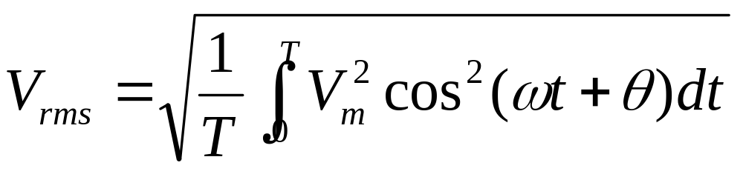
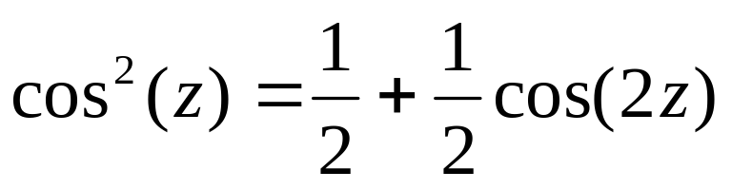

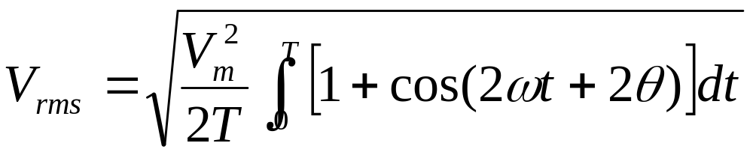
RMS Value of a Sinusoid

Slide 8
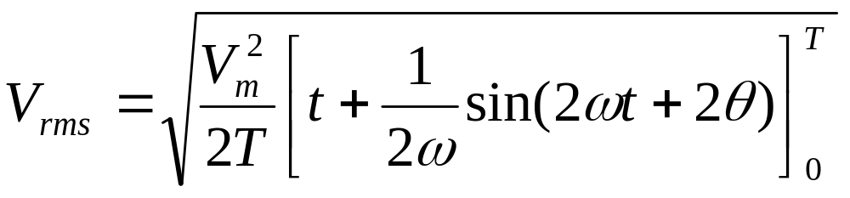
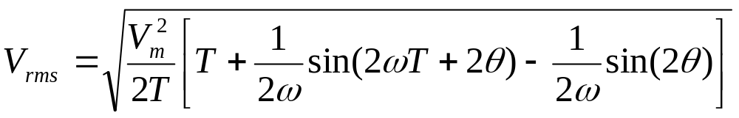
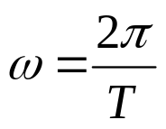
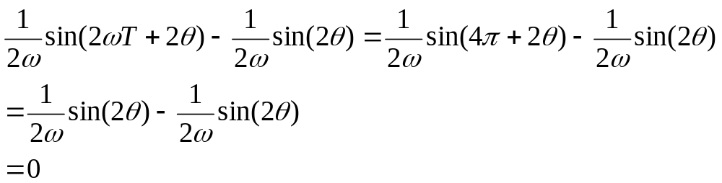
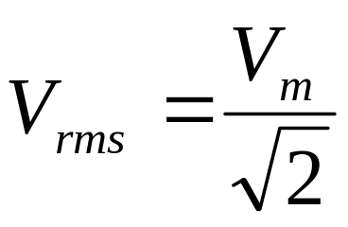
RMS Value of a Sinusoid

Slide 9
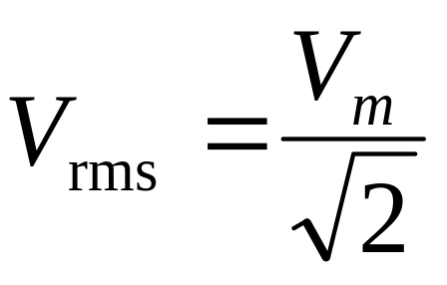
RMS Value of a Sinusoid
The rms value for a sinusoid is the peak value divided by the square root of two. This is not true for other periodic waveforms such as square waves or triangular waves.

Slide 10

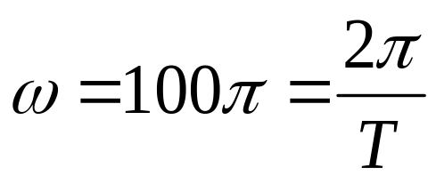
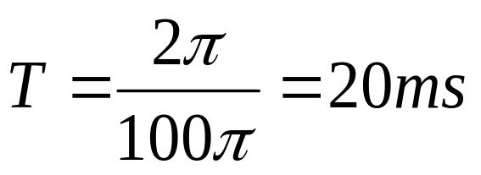
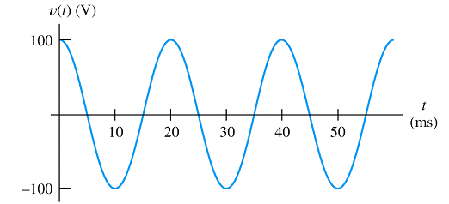
Example 5.1 Power delivered to a resistance by a sinusoidal source
A voltage is applied to a 50-Ω resistance.
Find
the rms value of the voltage.
Find the average power delivered to the resistance.
Find the power as a function of time and sketch to scale.
1.

Slide 11
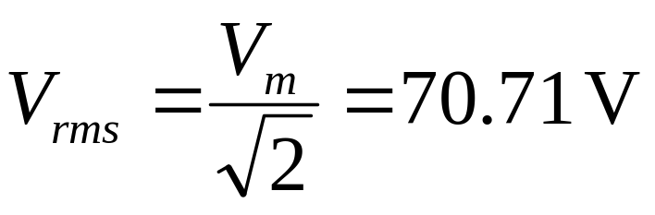
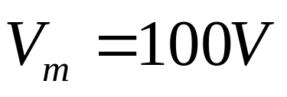
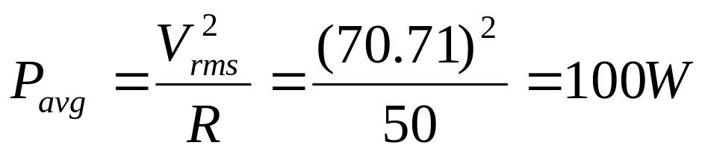
Example 5.1 Power delivered to a resistance by a sinusoidal source
2. The rms value of the voltage
3. The average power

Slide 12
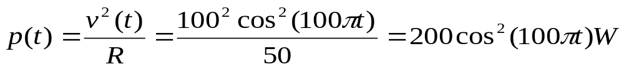
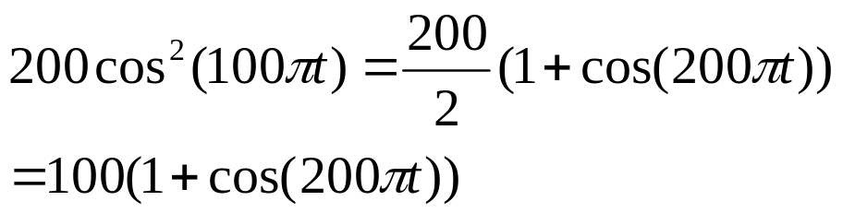
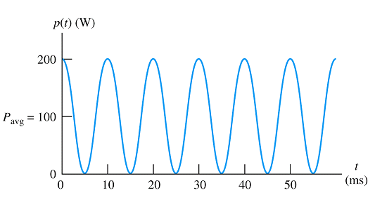
Example 5.1 Power delivered to a resistance by a sinusoidal source
4. The power as a function of time is

Slide 13
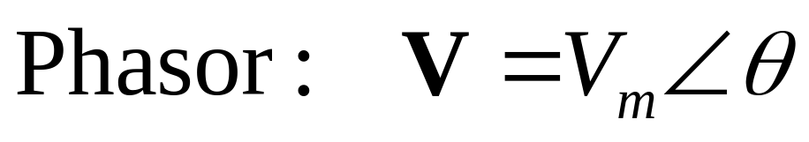
5.2 Phasors (相量)
Refer to Appendix A Complex Numbers
Phasor Definition
Phasor 以複數(complex numbers)來表示sinusoidal voltages or currents. Ex.
Magnitude (V₁) 代表最大振福(peak value).
Angle (θ₁)代表相位(phase).

Slide 14
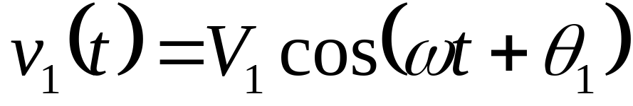
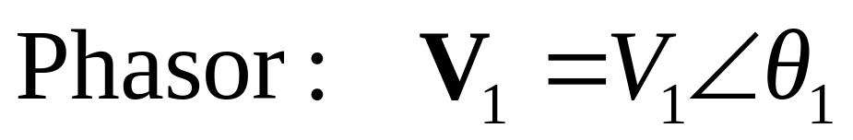
A sinusoidal cosine voltage
(Time function, 時間函數)
其 phasor 為

Slide 15
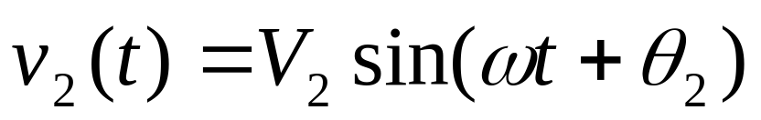
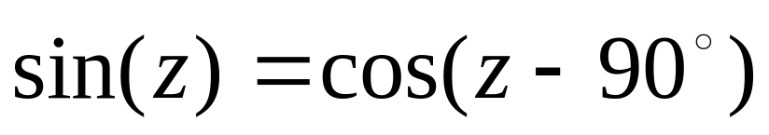
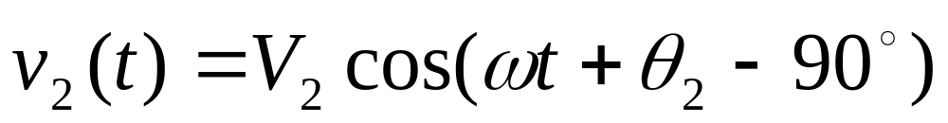
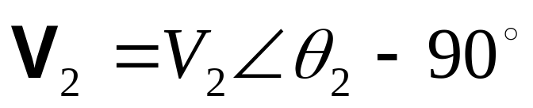
A sinusoidal sine voltage

Slide 16
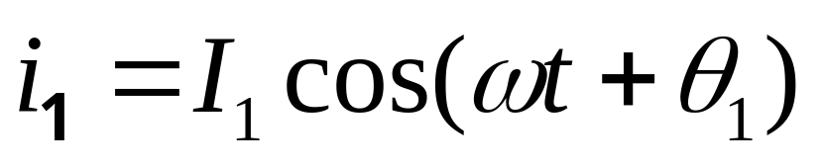
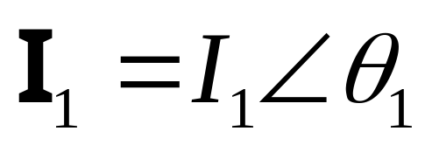
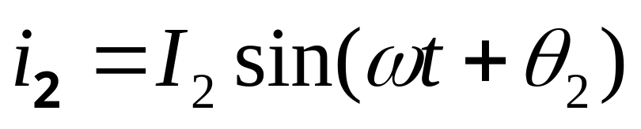
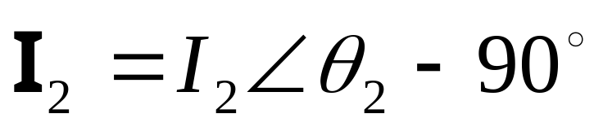
For sinusoidal currents
phasor
phasor

Slide 17
Adding Sinusoids Using Phasors
Step 1: Determine the phasor for each term.
Step 2: Add the phasors using complex arithmetic.
Step 3: Convert the sum to polar form.
Step 4: Write the result as a time function.

Slide 18
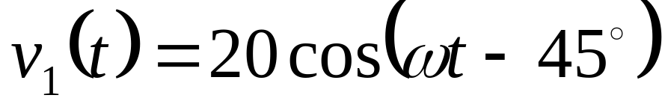
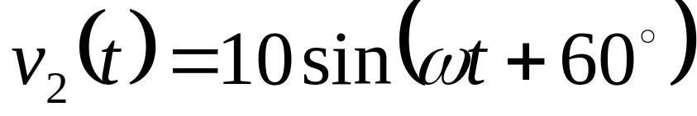

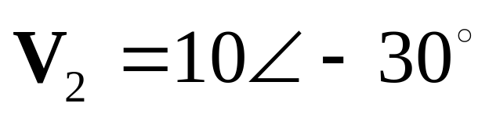
Using Phasors to Add Sinusoids
To find v_{s}(t)=v₁(t)+v₂(t).
1. The phasors
2. Complex arithmetic

Slide 19
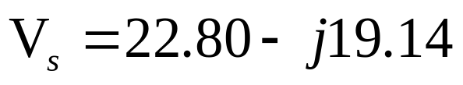




Using Phasors to Add Sinusoids
3. Convert the sum to polar form

Slide 20



Using Euler’s formula to Add Sinusoids
polar form

Slide 21



Visualization of Sinusoids
A sinusoidal voltage
Exponential form
Complex Polar form
Sinusoids 可視為複數向量(complex vectors) 隨時間改變在實數軸的投影量。

Slide 22





可視為Vector with length 以 角速度(angular velocity)在複數平面以逆時針(counterclockwise) 方向旋轉。
v(t)為 在實數軸的投影量。
v(t) 的Phasor
為 在t = 0時的向量。

Slide 23
Phasors as Rotating Vectors
Sinusoids can be visualized as the real-axis projection of vectors rotating in the complex plane.
The phasor for a sinusoid is a snapshot of the corresponding rotating vector at t = 0.

Slide 24
Phase Relationships from Phasors
1. To determine phase relationships from a phasor diagram, consider the phasors to rotate counterclockwise.
2. Then when standing at a
fixed point, if V₁ arrives first followed by V₂ after a rotation of θ , we say that V₁ leads V₂ by θ .
3. Alternatively, we could say that V₂ lags V₁ by θ . (Usually, we take θ as the smaller angle between the two phasors.)

Slide 25

Phase Relationships from Phasors
V₁ leads V₂ by 60º .

Slide 26
Phase Relationships from Time Functions
To determine phase relationships between sinusoids from their plots versus time,
1.find the shortest time interval t_{p} between positive peaks of the two waveforms.
2.Then, the phase angle is
θ = (t_{p}/T ) × 360°.
3.If the peak of v₁(t) occurs first, we say that v₁(t) leads v₂(t) or that v₂(t) lags v₁(t).

Slide 27

v₁(t) leads v₂(t) by θ (60º).
θ = (t_{p}/T ) × 360°.
t_{p}
t

Slide 28




Exercise 5.5
State the phase relationship between each pair of voltages.
+30º
-30º
-45º

Slide 29



5.3 COMPLEX IMPEDANCES (複數阻抗)
Inductance
假設通過電感L的 sinusoidal current 為
則電感L兩端的voltage為
(亦為sinusoid)

Slide 30





Inductance
Voltage & current 的 phasors 為
Current lags the voltage by 90º
ωLI_{m}
I_{m}

Slide 31







Ohm’s Law
What is the relationship between phaor vltage and phasor current? Does it be similar to Ohm’s law?
( )
稱為L的阻抗(impedance)

Slide 32

Phasor voltage = impedance ×phasor current (similar to Ohm’s law)
Note the impedance of an inductance is an imaginary number 虛數 (called reactance). Resistance is a real number.

Slide 33






Capacitance
假設通過電容C的 sinusoidal voltage為
則電容C兩端的current為

Slide 34


Capacitance
( )
Current leads the voltage by 90º

Slide 35

Capacitance

Slide 36


Resistance
The current and voltage are in phase. (同相位)

Slide 37






電容阻抗
電感阻抗
電阻
Current leads voltage by 90º
Current lags voltage by 90º
Current and voltage are in phase

Slide 38
Kirchhoff’s Laws in Phasor Form
5.4 Circuit Analysis with Phasors and Complex Impedances
We can apply KVL directly to phasors. The sum of the phasor voltages equals zero for any closed path.
KCL-The sum of the phasor currents entering a node must equal the sum of the phasor currents leaving.

Slide 39
Circuit Analysis Using Phasors and Impedances
1. Replace the time descriptions of the voltage and current sources with the corresponding phasors. (All of the sources must have the same frequency.)
2. Replace inductances by their complex
impedances Z_{L} = jωL. Replace
capacitances by their complex impedances
Z_{C} = 1/(jωC) or –j(1/ωC) . Resistances
have impedances equal to their resistances.

Slide 40
3. Analyze the circuit using any of the techniques studied earlier in Chapter 2, performing the calculations with complex arithmetic.

Slide 41


Example 5.4 Steady-state AC Analysis of a Series Circuit
I?
V_{R}?
V_{L}?
V_{C}?
1. Phasors

Slide 42







2. Complex impedances
( )

Slide 43


3. Circuit Analysis

Slide 44



3. Circuit Analysis
Note

Slide 45

Figure 5.13 Phasor diagram for Example 5.4.

Slide 46


Example 5.5 Series and Parallel Combinations of Complex Impedances.
V_{C}?
I_{L}?
I_{R}?
I_{C}?
1. Phasors

Slide 47





2. Complex impedances
Or

Slide 48



3. Circuit Analysis

Slide 49



Slide 50


Slide 51






Example 5.6 Steady-State AC Node-Voltage Analysis
v₁(t)?
1. Phasors
2. Complex impedances

Slide 52






3. Circuit Analysis
KCL
Node 1
KCL Node 2
∵

Slide 53



Slide 54




5.5 Power in AC Circuits
阻抗有實數(電阻)或虛數 (電感, 電容),
功率有無實虛?

Slide 55






1. If X=0
實阻抗(純電阻 )
(參考Ch5.1)
實功率
(real power)

Slide 56

1. If X=0
實阻抗(純電阻 )

Slide 57






2. If R=0, X>0
虛阻抗 (電感性)
虛功率 or 無效功率
(Reactive power)

Slide 58





3. If R=0, X<0
虛阻抗 (電容性)
虛功率 or 無效功率
(Reactive power)

Slide 59




Power for a General Load
一般狀況 R≠0且X≠0, RLC 電路 (有實與虛阻抗)
( )

Slide 60




積分為0
積分為0

Slide 61






為real power (有效功律or 實功率)
單位為W
為power factor, PF (功率因子)
為power angle (功率角)代表電流lags電壓的角度
為apparent power (視出功律)
單位為VA(volt-amperes)
為reactive power (無效功律or 虛功率), 單位為
VAR (volt amperes reactive)

Slide 62





AC Power Calculations
(W)
(VAR)
(VA)

Slide 63



(VA)
(W)
(VAR)

Slide 64






Proof:
Proof:

Slide 65
Appendix A
Complex Numbers

Slide 66

Basic Complex-Number Concepts
Complex numbers involve the imaginary number(虛數) j =
Z=x+jy has a real part (實部) x and an imaginary part (虛部) y , we can represent complex numbers by points in the complex plane (複數平面)
The complex numbers of the
form x+jy are in rectangular
form (直角座標)
Imaginary
y
Z
Real
x

Slide 67




The complex conjugate (共軛複數) of a number in rectangular form is obtained by changing the sign of the imaginary part.
For example if then the complex conjugate of is

Slide 68


Example A.1 Complex Arithmetic in Rectangular Form
Solution:
to rectangular form

Slide 69

Example A.1 Complex Arithmetic in Rectangular Form

Slide 70



Slide 71


Complex Numbers in Polar Form(極座標)
Complex numbers can be expressed in polar form (極座標). Examples of complex numbers in polar form are :
The length of the
arrow that represents a complex
number Z is denoted as |Z|
and is called the magnitude
(幅值 or 大小) of the complex number.

Slide 72


Using the magnitude |Z| ,
the real part x, and the
imaginary part y form a
right triangle (直角三角形).
Using trigonometry, we can
write the following relationships:
These equations can be used to convert numbers from polar to rectangular form.
(A.1)
(A.2)
(A.3)
(A.4)

Slide 73

Example A.2 Polar-to Rectangular Conversion

Slide 74

Example A.3 Rectangular-to-Polar Conversion
Z₆
Z₅
153.43º
11.18
5
5
26.57º
-10
10
Figure A.4

Slide 75



Slide 76

The procedures that we have illustrated in Examples A.2 and A.3 can be carried out with a relatively simple calculator. However, if we find the angle by taking the arctangent of y/x, we must consider the fact that the principal value of the arctangent is the true angle only if the real part x is positive. If x is negative,
we have:

Slide 77




Euler’s Identities
The connection between sinusoidal signals and complex number is through Euler’s identities, which state that
and
Another form of these identities is
  and

Slide 78





is a complex number having a real part of and an imaginary part of
The magnitude is

Slide 79




The angle of
A complex number such as can be written as
We call the exponential form (指數形式)of a complex number.

Slide 80
Given complex number can be written in three forms:
  The rectangular form
  The polar form
  Exponential form

Slide 81


Example A.4 Exponential Form of a Complex Number
Solution:

Slide 82


Arithmetic Operations in Polar and Exponential Form
To add (or subtract) complex numbers, we must first convert them to rectangular form. Then, we add (or subtract) real part to real part and imaginary to imaginary.
Two complex numbers in exponential form:
The polar forms of these numbers are

Slide 83



For multiplication of numbers in exponential form, we have
In polar form, this is
Proof:
( )

Slide 84


Now consider division:
In polar form, this is

Slide 85


Example A.5
Complex Arithmetic in Polar Form
Solution:
  Before we can add (or subtract) the numbers, we must convert them to rectangular form.

Slide 86


  The sum as Zs:
  Convert the sum to polar form:
  Because the real part of Z_{s} is positive, the correct angle is the principal value of the arctangent.

